Slide 1
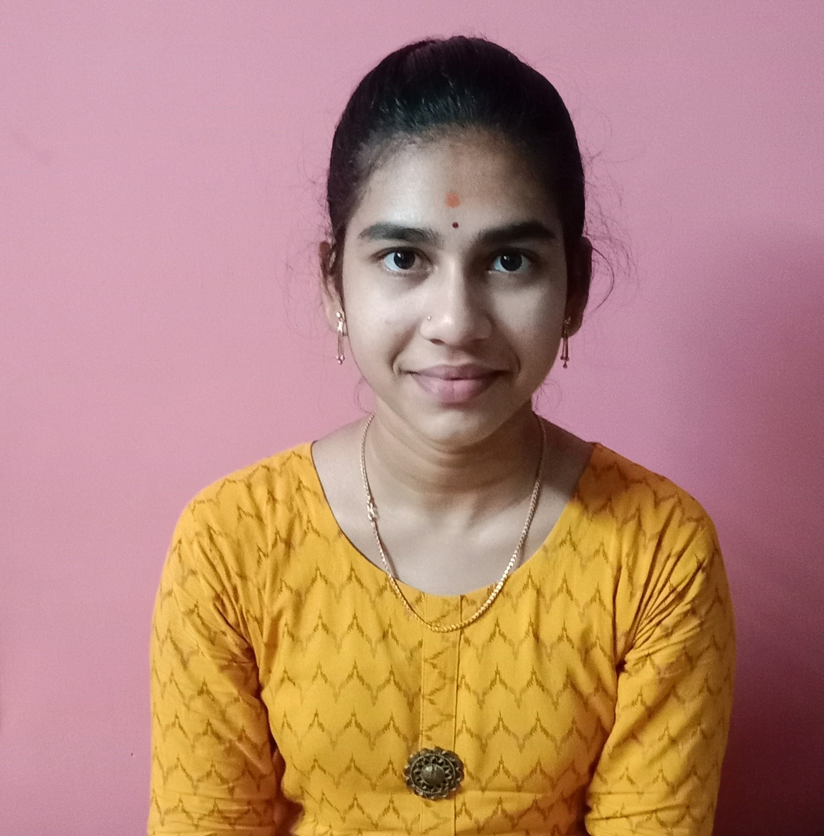
Student Details
Name : PAIDIMUKKALA JAHNAVI
SkillsBuild Email ID : jahnavipaidimukkala@gmail.com
College Name : Sri Vasavi Engineering College
College State : AndhraPradesh
Internship Domain : Frontend Development
Start Date : 6th June 2023
End Date : 4th July 2023

Slide 2
Project Title/Problem Statement
PORTFOLIO
As a part of internship, we have to do a project on Frontend Development. Our project is to build an attractive and effective portfolio, which shows my skills and the details about me.
It is a website of portfolio , which means it contains all my skills, projects, internships and other activities.
I developed this portfolio with the help of some inbuilt libraries which I learnt in this internship session.

Slide 3
Agenda
The main agenda of this project is to build a portfolio which is helpful for fresher’s to create their own portfolio by this internship.
In this internship I learnt various libraries to give effects and design a website with different effects.
Applying the learnt skills to build this portfolio website.

Slide 4
Project Overview
Purpose :Portfolio assessment enables students to reflect their real performance, to show their weak and strong domain and to observe student’s progress during the learning process, and encourages students to take responsibilities for their own learning.
Scope : Build in opportunities for Peer-to-Peer learning. Create lessons that foster data and knowledge curation .Engaging for all levels of learners. Develop organization skills and plan for the future.
Objective : The main objective is a compilation of materials that exemplifies your beliefs, skills, qualifications, education, training and experiences. It provides insight into your personality and work ethic with portfolio.

Slide 5
Who are the end users of this project?
Every person should have their own portfolio which contains all the details related to them, the skills which they know and the projects which they have done in their academics or by their own interest.
For an organization, this portfolio helps to select the employes who have related skills according to the available role in the company.
By referring this portfolio of a person it will be easy to the company to hire the people.

Slide 6
Yours solution and its value proportion
In this advanced world we need to showcase our skills digitally.
So, the solution is to connect with the world digitally with your portfolio to get a better opportunities.
Connect with peers to enhance your skills and experiences.

Slide 7
How did you customize the project and make it your own
There are types of portfolio’s for different purposes, Here making customized portfolio with the unique features of a fresher by showcasing their projects , on which skills there are good at and the certifications they have done.
I customized my project as simple and effective with important options like projects , skills , certificates that I have and extracurricular activities that I have participated.
Its been useful and helpful to start a career digitally by showcasing my capabilities.

Slide 8
Modelling
Technologies used
1.HTML
It describes the structure of the webpage , we can design accordingly to our needs.
2. CSS
The cascading style sheet is used to give an attractive look to the website.
3. Bootstrap
Bult-in library which contains the code for the multiple components.
Frameworks : Bootstrap, AOS, Animate.css, Bootstrap icons, Fevicon generator, Google Fonts these are the libraries that are used to build this portfolio.

Slide 9
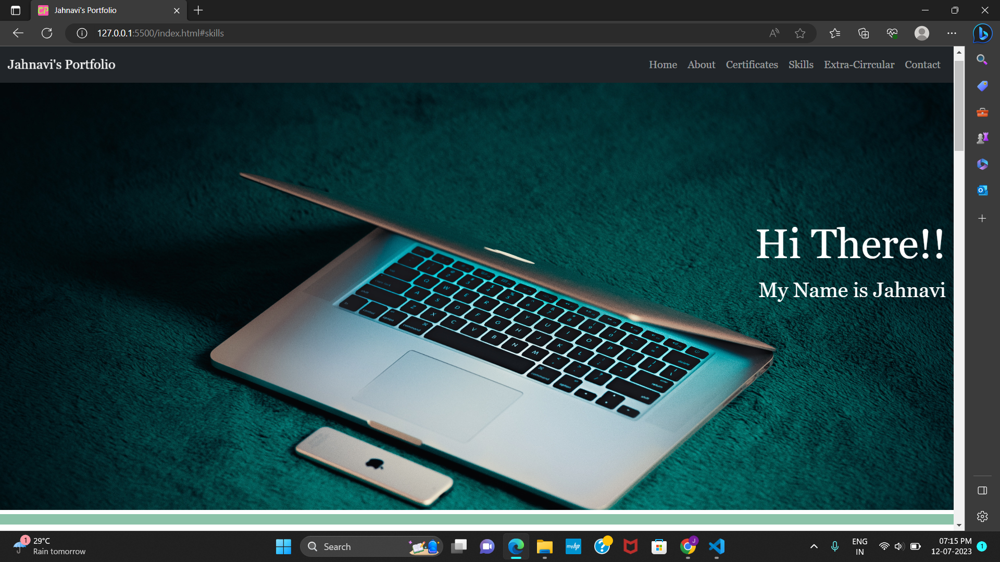
Result

Slide 10
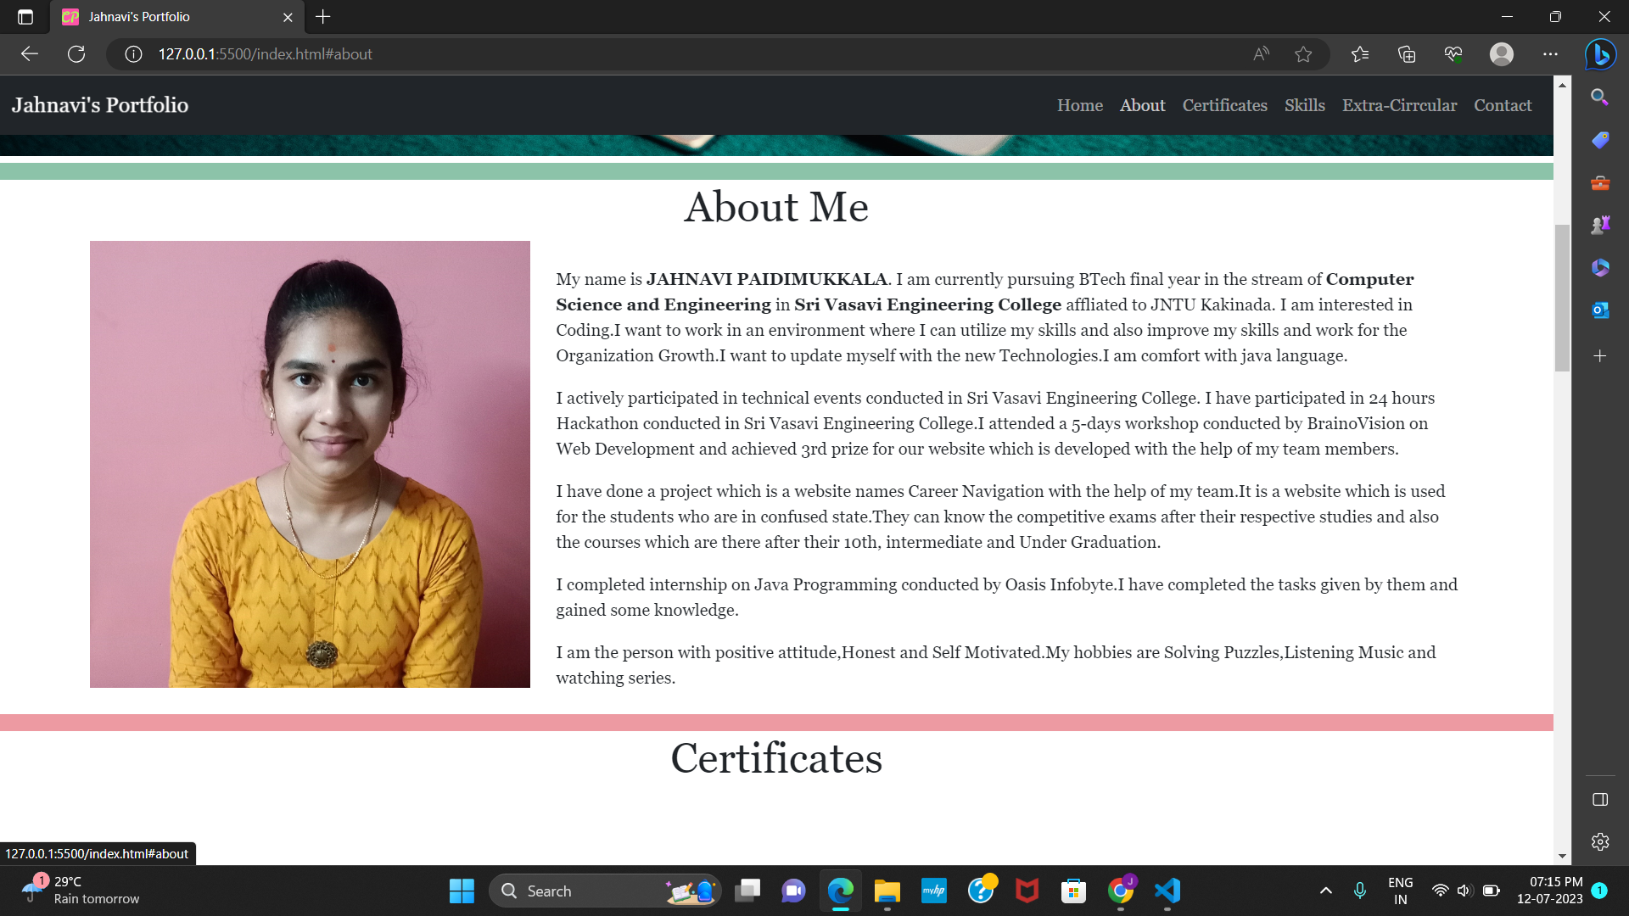

Slide 11
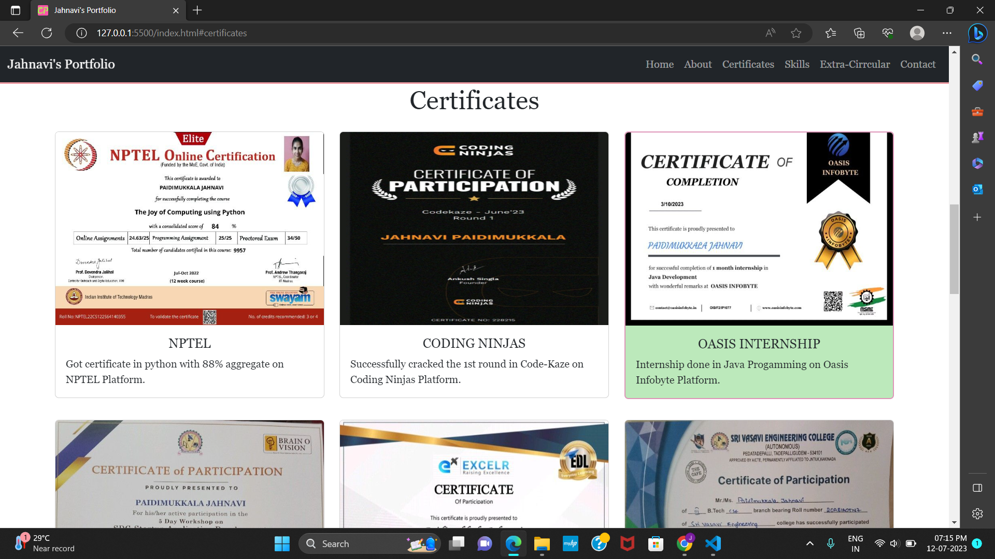

Slide 12
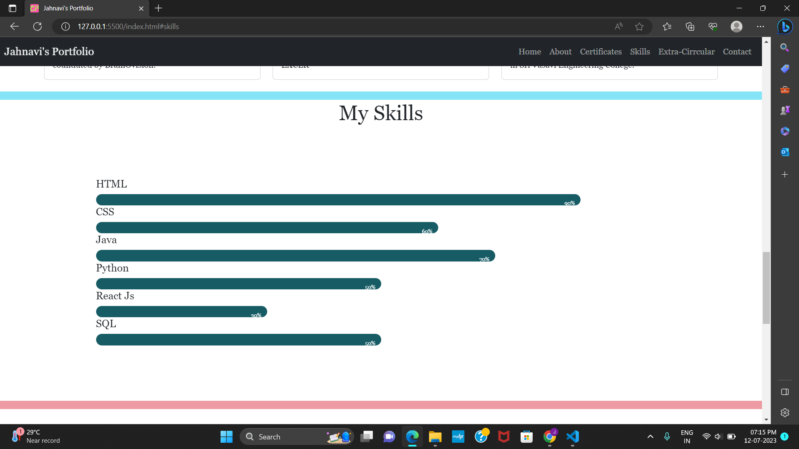

Slide 13
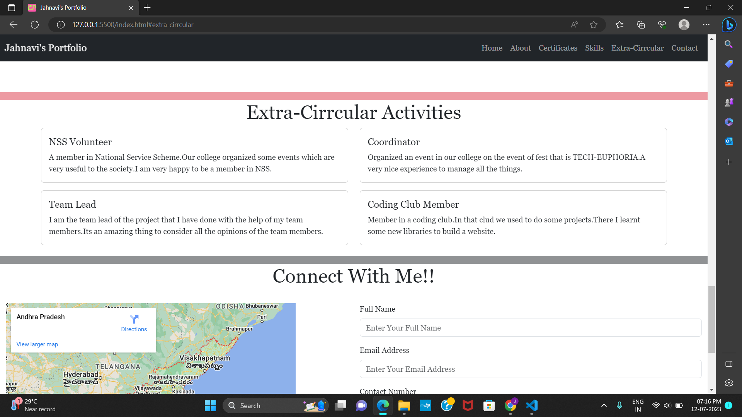

Slide 14
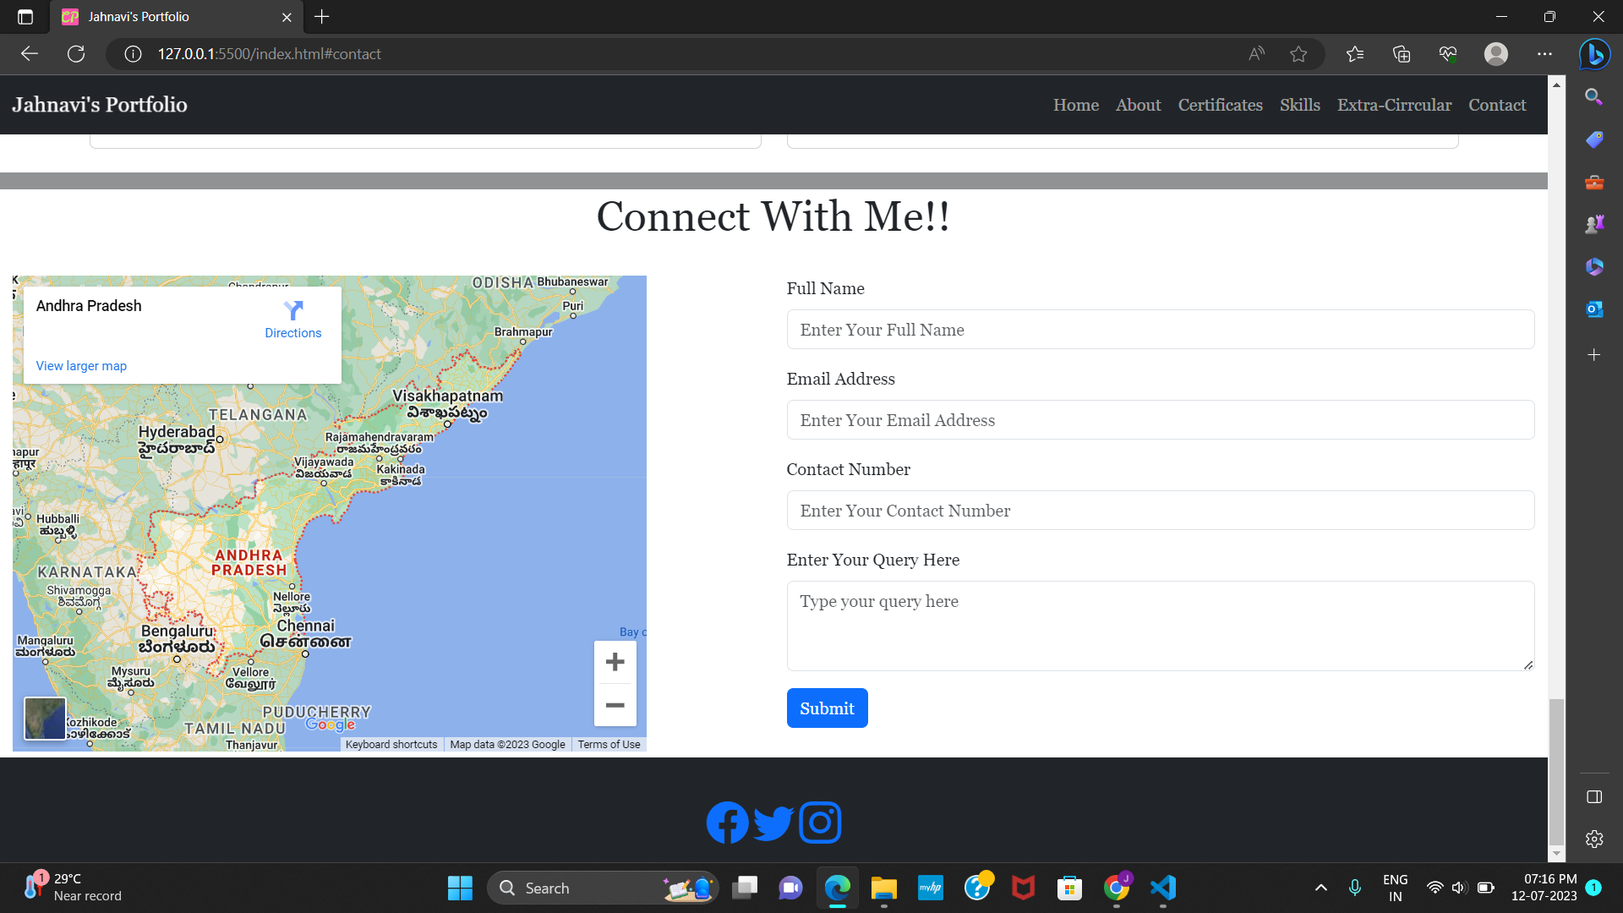

Slide 15
Links
Git hub link:https://jahnavi-code.github.io/Portfolio/
Drive link :https://drive.google.com/drive/folders/1qMtcWhqAHGxy0aDqllDuedKhbfJZIOIH?usp=drive_link

